Slide 1
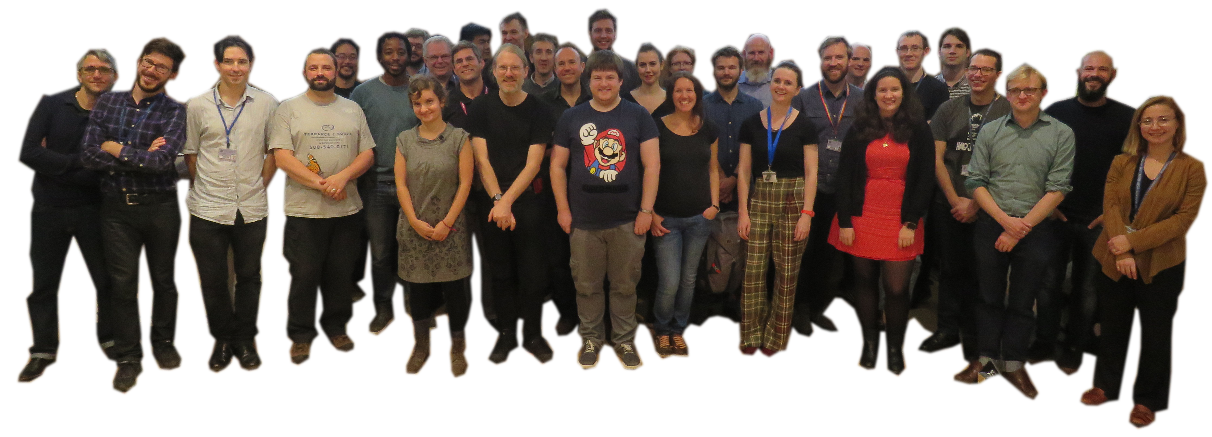
Community of Edinburgh RSEs (CERSE)

Slide 2
Outline
Background
EPCC
Software Sustainability Institute (SSI)
Research Software Engineers (RSEs)
Community of Edinburgh RSEs (CERSE)
Edinburgh Carpentries (if there is time)
Opportunities (if there is time)

Slide 3

EPCC
Established in 1990
Institute emerged from the Physics department interest in parallel computing
Ethos to popularise Parallel Computing in academia/industry
Self funded, project based work
Currently have over 100 people
Area of interest extended well beyond parallel computing
Novel architectures
Data Science
But still into High Performance Computing
Run ARCHER the UK National Supercomputing Service
Aug 2018 moved from JCMB, King’s Buildings -> Bayes Centre

Slide 4

Software Sustainability Institute (SSI)
Established in 2010
Ethos: Better software -> Better Research
Do this through:
Training, e.g. Carpentries
Community building, Fellows, Workshops
Consultancy
Policy Building
Outreach
Virtual institute composed:
University of Edinburgh
University of Manchester
University of Southampton
University of Oxford

Slide 5
What is an Research Software Engineer (RSE)?
if you answer yes to any of the following questions, you are working as an RSE:
Are you employed to develop software for research?
Are you spending more time developing software than conducting research?
Are you employed as a postdoctoral researcher, even though you predominantly work on software development?
Are you the person who does computers in your research group?
Are you sometimes not named on research papers despite playing a fundamental part in developing the software used to create them?
Do you lack the metrics needed to progress your academic career, like papers and conference presentations, despite having made a significant contribution through software?
From https://rse.ac.uk

Slide 6

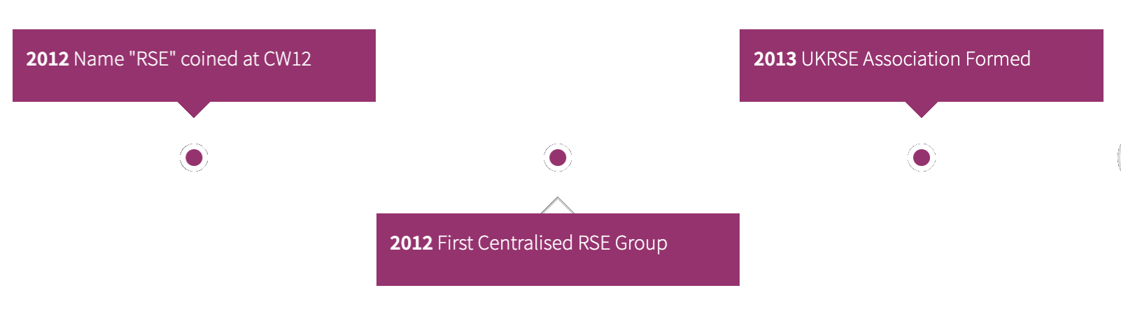
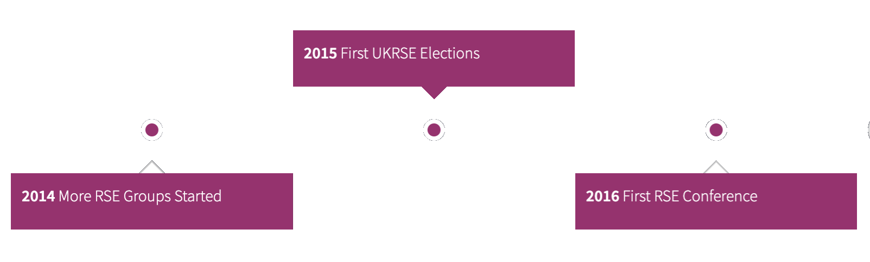

RSEs
People who:
Develop software as part of their research or
Develop software for others to do research
A spectrum of people
Part of a bigger national movement
https://www.society-rse.org/
Help develop career paths in academia
SSI pivotal in establishing & gaining international traction

Slide 7
Society of RSEs
Society of Research Software Engineers was launched in March 2019
Charitable Incorporated Organisation
You can become a member for £20 pa
Gives you voting rights, help shape the movement
Have had 4 UK annual meetings since 2015
2 Manchester + 2 Birmingham
Next location to be determined
How does CERSE fit into all this?
Community of Edinburgh RSES is an effort to bring local RSEs together

Slide 8
CERSE Goals
Cater to Research Software Engineers (RSEs) in Edinburgh.
Researchers whose main interest lies in developing software.
Bring together people whose role is to develop research software.
Networking opportunity – get to know other similar people in Edinburgh.
Forum for discussion:
Exchange tips, resources, form special interest groups, training, opportunities, etc.
Act as a lobby group.
Contextualise to particular institutions.
End up as:
a grass-roots, sustainable, self supporting franchise.

Slide 9
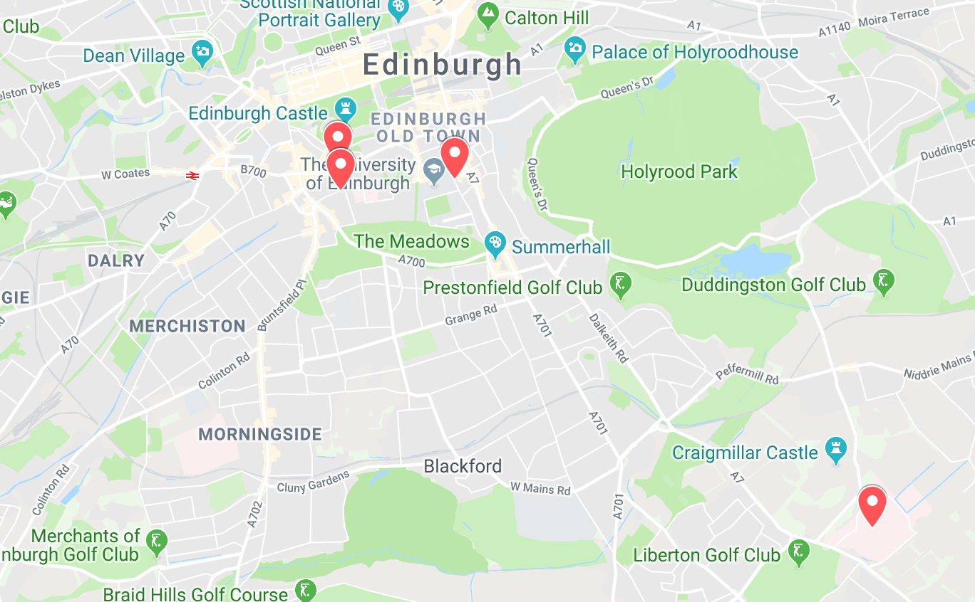
Four meetings so far
Try to move around Edinburgh
Bayes Centre
Edinburgh College of Art
Argyle House
Chancellor’s Building
Mostly UoE centric
Convenience
All very central
Target other UoE Campuses

Slide 10
Number of Attendees at CERSE events

Slide 11
Keeping in touch
Join the RSE Association: www.society-rse.org
Join the RSE Slack:
https://ukrse.slack.com/join/signup
and join the #edinburgh channel
Join the CERSE mailing list:
Ed-rse-community@jiscmail.ac.uk
Help us build this community!
Suggest events or activities
Help organise or host
Bring a friend along

Slide 12
Training - Carpentries
Started by Greg Wilson in North America
The SSI was primary in spreading to UK/Europe
Teach basic computing skills to students and staff
Started with Software Carpentries (software-carpentry.org) then …
Data Carpentry (datacarpentry.org)
Library Carpentry (librarycarpentry.org)
HPC Carpentry – in development (hpc-carpentry.github.io)
etc.
S/W, Data, Library come under “The Carpentries” (carpentries.org)
Type of carpentry emphasizes the subjects modules that are taught

Slide 13



So what is taught?
Bash shell (0.5 d)
Git (0.5 d)
Python (1 d)
Intro to data (0.5 d)
Unix shell (0.5 d)
Open Refine (0.5 d)
Intro to git/Python (0.5 d)
Spreadsheets (0.25 d)
Open Refine (0.25 d)
R (1.5 d or 1 d + SQL 0.5 d)
Typically run over 2 days but other scenarios possible
Content is customisable – can swap modules in/out
Focus is on good practice
Can be tailored to specific domains, e.g. ecology, genomics, etc.
Lessons available on-line under a CC-BY licence
Free to use but to call yourself a Carpentry and use infrastructure a fee is involved
Edinburgh University taken out a Gold organizational membership
Notes:
Individual carpentry logos: https://github.com/carpentries/carpentries.org/tree/gh-pages/images/logos
The Carpentries logo: https://github.com/carpentries/carpentries.org/blob/gh-pages/assets/img/TheCarpentries.svg

Slide 14

How is it taught?
Instructor led
Instructor at the front types content on own laptop
Students
Type content on own laptops (most of the time)
End up with a working copy of application/software on own machine
Take away copies of software
Given red/green post-it notes
Helpers
Help students who run into (a) problem(s)
Signal by sticking the red post-it note at the top of the laptop

Slide 15

What is EdCarp?
Coordinated approach to teach Carpentries in Edinburgh
Provision of Instructors and helpers
Using a GitHub organizational repository:
https://github.com/edcarp
From Sep 2018 – March 2019
Run 11 events
Trained 170+ people (missing some data)
97 students, 52 staff, 21 unknown

Slide 16
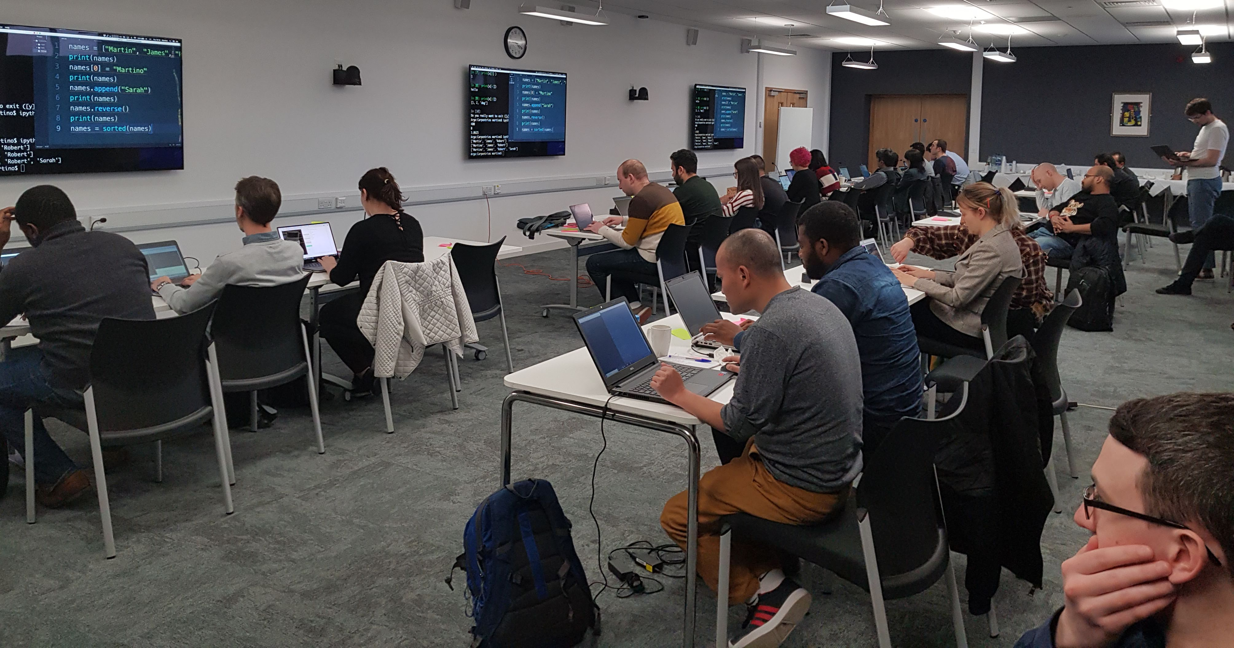
Typical example
Software Carpentry at HW on 28/03/2019. Data Carpentry at HW on 26/06/19.

Slide 17

EdCarp Conclusions
If you want to be involved get in touch
You could host a Carpentry event
Always on the look-out for Instructors/Helpers
Attendee -> Helper -> Instructor
Need:
Organisational structure (committees) and
Clearer institutional support (money & admin support)
Ongoing development of new curricula
Text mining, biology, AI, …
Feedback for events has always been positive
Need to do longitudinal studies
Much aligned with the SSI’s ethos:
Better Software -> Better Research

Slide 18
Conclusions
Have briefly described:
EPCC
Software Sustainability Institute
CERSE
EdCarp
SSI is serving the UK research community:
Software forms an important component of research
Want people to get better recognition for this
Would be good to continue CERSE in the BioQuarter:
Need local representation
Probably want a meeting roughly every 2 months
Thanks to Riinu Ots, Tahira Akbar and Sean McGeever

Slide 19
References
EPCC – https://www.epcc.ed.ac.uk
SSI – https://www.software.ac.uk
RSE – https://rse.ac.uk also https://www.society-rse.org/
CERSE - https://cerse.github.io/
The Carpentries - https://carpentries.org/
EdCarp - https://edcarp.github.io/

Slide 20
SSI 2019 Fellowship Programme
If your passion is for software and you are a good networker
£3000 grant
Look at http://bit.ly/SSI-FP for 2019
Webinar 15:00 to 16:00 BST Friday, October 11th, 2019
October 29th, 2019 - Applications close at 23:59 GMT
From 2012 - 2018: 112 Fellows, 40 Institutions
Diversity of domain, career stage, professions

Slide 24
Cirrus access
Tier-2 resource based at EPCC
280 node HPE/SGI 8600 HPC system with a DDN Lustre file system
Nodes contain two 2.1 GHz, 18-core Intel Xeon E5-2695 (Broadwell)
Nodes have 256 GB of memory shared between the two processors
More details at:
http://www.cirrus.ac.uk/about/hardware.html
Free access for Scottish academics:
http://www.cirrus.ac.uk/access/scottish.html
Test access of 15000 Core-hours for up to 6 months
Production of 100000 Core-hours for up to a year

